Slide 1
Did you know 24 whales have died in captivity in 25 years at SeaWorld?

Slide 2
Should the captivity of marine animals be allowed for human enjoyment?
Rebecca Hunter

Slide 3
Research
The ways they are capturing these marine animals are wrong and have deadly effects.
Pneumonia
Death from shock or stress
spontaneous abortions
it also causes the animals who are returned to take drastic measures to save those who are captured.

Slide 4
Research
Why are we taking them captive?!
Health, manmade issues, education
How is their life in captivity?
Cramped tanks with chlorinated water
no mental stimulation
little variety of food

Slide 5
Research
Is this truly helpful for the animals?
32 live birth animals are dead already
orca death rates are one per year
28 live births, 9 deceased and 10 mothers

Slide 6
Research
How are we helping?
Marine legislation Mammal Protection Act
maintaining the environment we share
creating husbandry standards for zoos and aquariums

Slide 7
Because I researched if the captivity of marine animals should be allowed I performed a beach clean up for my product eliminating some of the causes of captivity.

Slide 8
Product
Find a mentor
Find a company to work with
Spread the news
Come up with what exactly would happen at the clean up

Slide 9
Product
Find a company to work with
look up companies that clean up the beach normally
contact SUP, Stand Up Paddleboarding: Stand up for a clean ocean
plan the day

Slide 10
Product
Plan the day
Arrival and travel
Supplies
Cleaning up
Departure

Slide 11
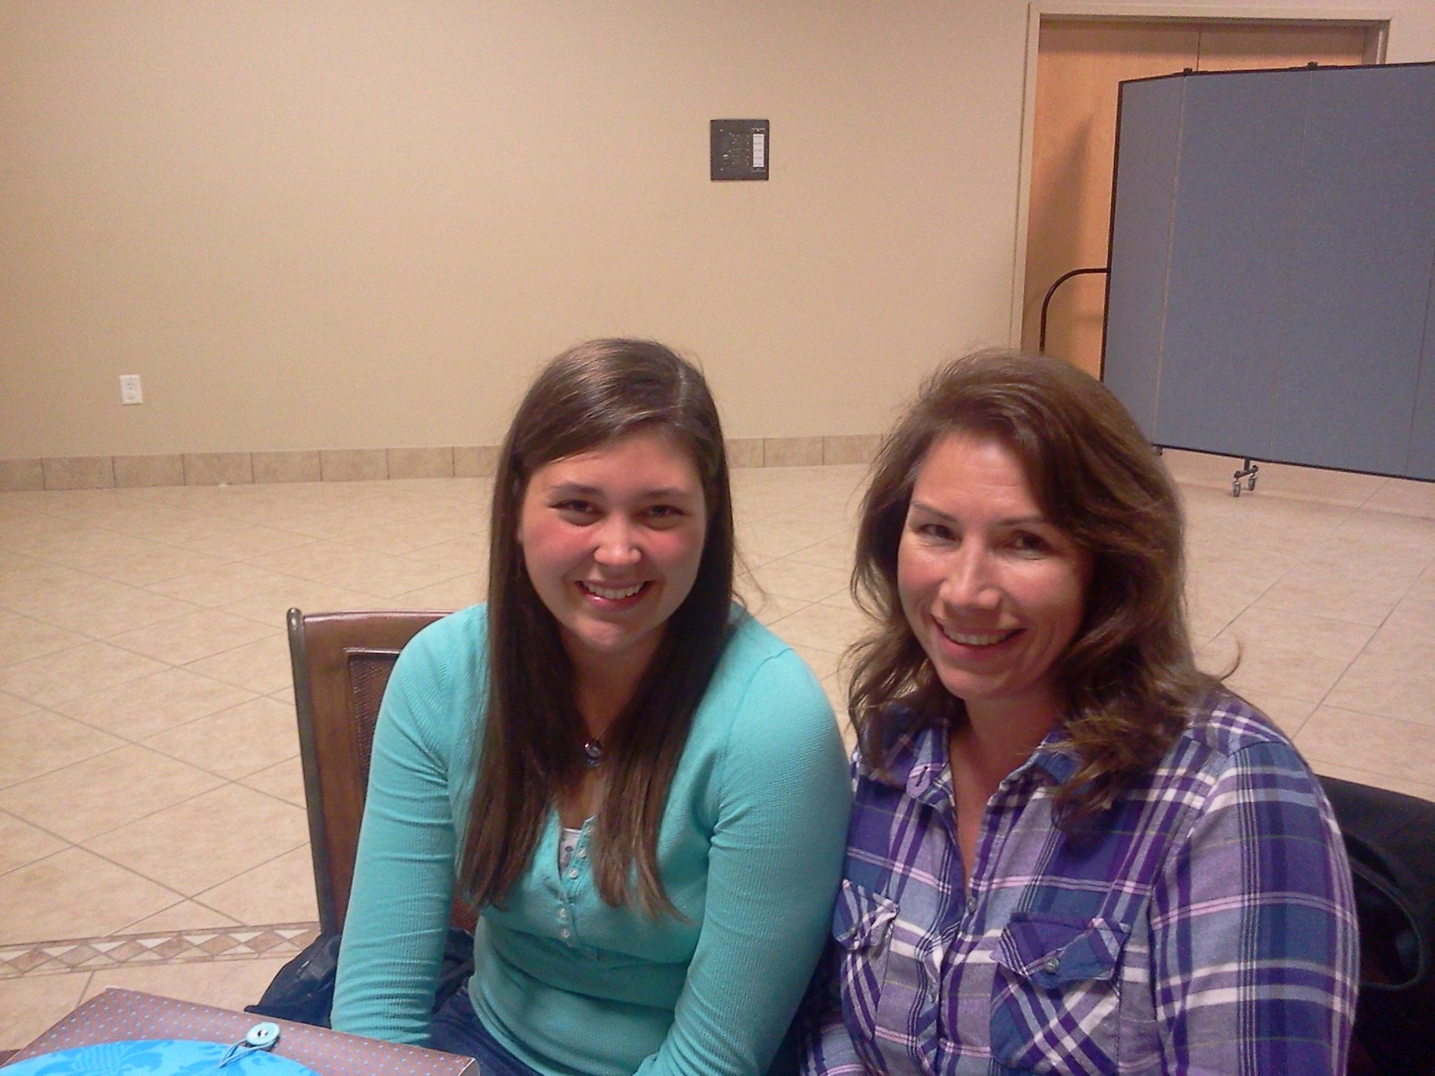
Mentor
Kimberly Phillips
She is an animal lover who likes to go out of her way to help all creatures in their normal habitat.
She helped me with stress, planning, and organizing my visual aid and presentation

Slide 12
Challenges and Successes
Challenges
Communication
Finding a mentor
Successes
Good turnout
Better at time management
Commitment to work with SUP along with others that went

Slide 13
What I learned
Time management
Better communication skills
About environmental cleanliness being important
I also learned that I love to help out animals and the environment, and that a job in a field with animals would be absolutely perfect and fun.

Slide 14
Thank you for taking time out of your busy lives to listen to my presentation. I hope you enjoyed it. Do you have questions?

